Slide 1
TA Session #HW1
賴冠廷 陳昀靖

Slide 2
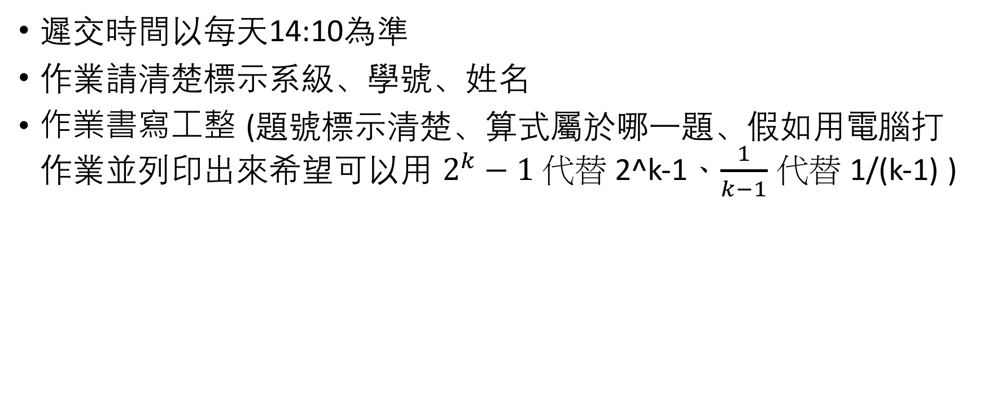
Note
遲交時間以每天14:10為準
作業請清楚標示系級、學號、姓名
作業書寫工整 (題號標示清楚、算式屬於哪一題、假如用電腦打作業並列印出來希望可以用 $2^{k}−1$ 代替 2^k-1、$\frac{1}{k−1}$ 代替 1/(k-1) )

Slide 3
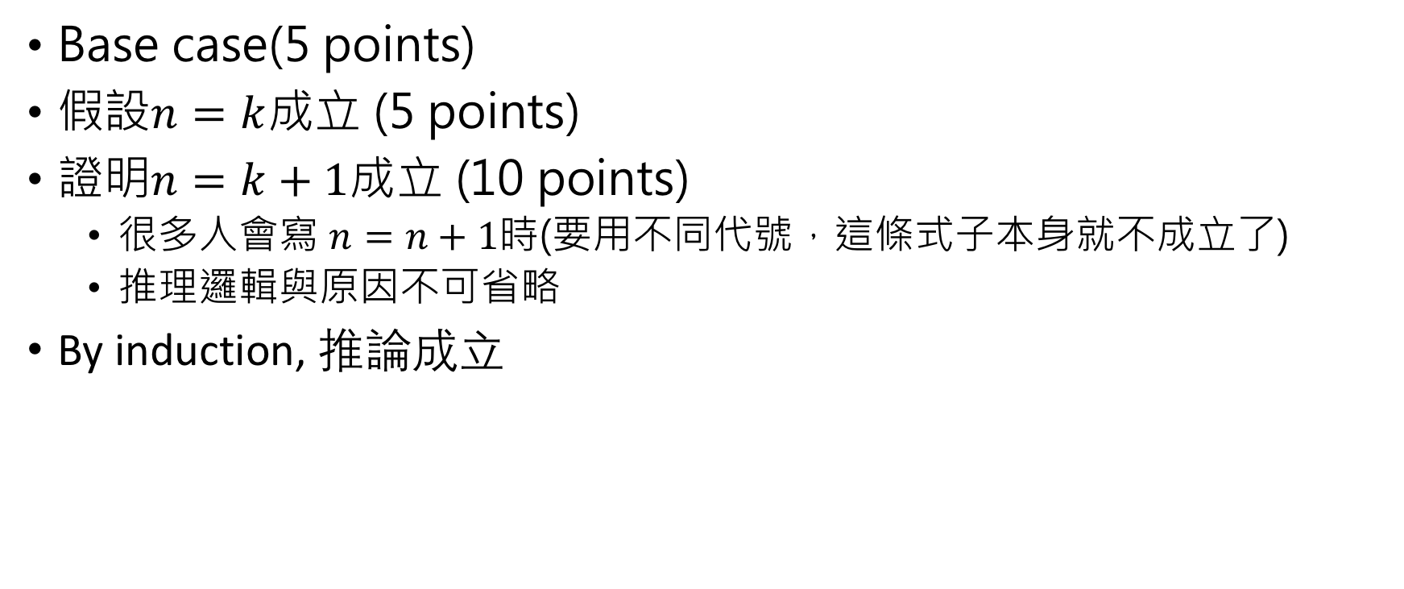
Prove by Induction
Base case (5 points)
假設$n=k$成立 (5 points)
證明$n=k+1$成立 (10 points)
  很多人會寫 $n=n+1$時(要用不同代號，這條式子本身就不成立了)
  推理邏輯與原因不可省略
By induction, 推論成立

Slide 4
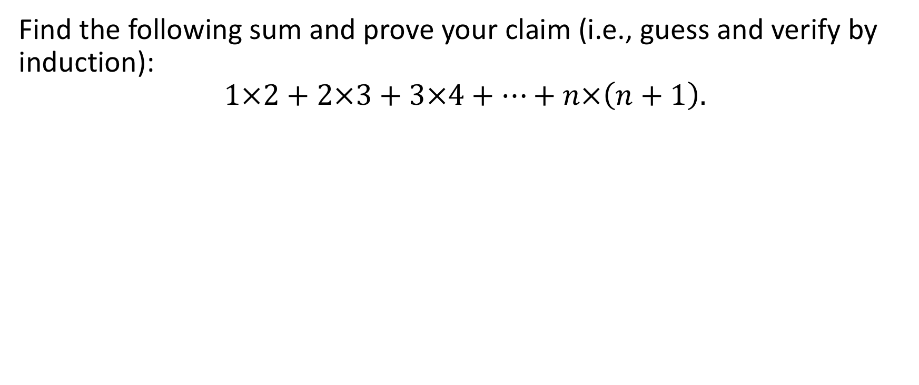
Q1.
Find the following sum and prove your claim (i.e., guess and verify by induction):
$$1×2+2×3+3×4+⋯+n×\left(n+1\right).$$

Slide 5
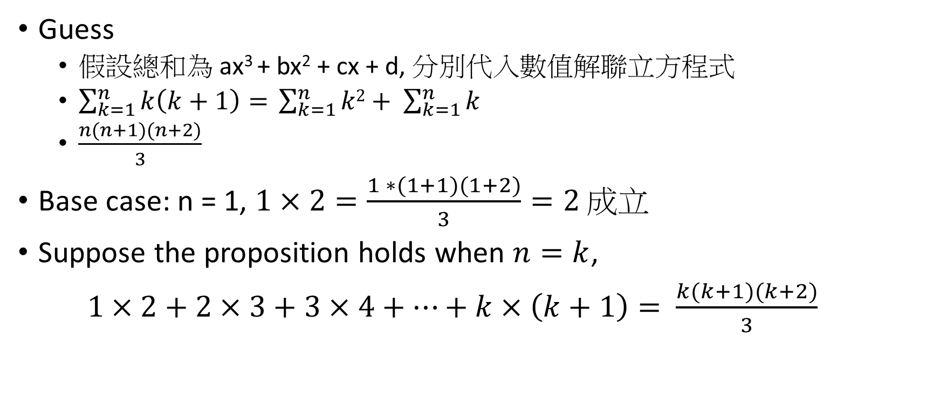
Q1.
Guess
  假設總和為 ax³ + bx² + cx + d, 分別代入數值解聯立方程式
  $\sum_{k=1}^{n}{k\left(k+1\right)= }\sum_{k=1}^{n}{k2}+ \sum_{k=1}^{n}{k}$
  $\frac{n(n+1)(n+2)}{3}$
Base case: n = 1, $1×2=\frac{1 ∗(1+1)(1+2)}{3}=2$成立
Suppose the proposition holds when $n=k$,
$1×2+2×3+3×4+⋯+k×\left(k+1\right)=$ $\frac{k(k+1)(k+2)}{3}$

Slide 6
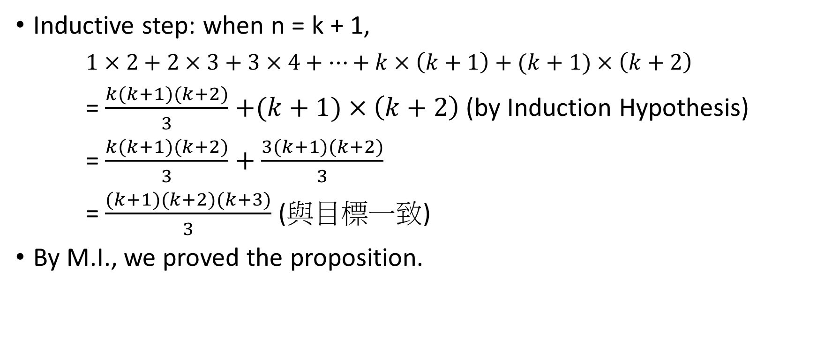
Q1.
Inductive step: when n = k + 1,
$1×2+2×3+3×4+⋯+k×\left(k+1\right)+(k+1)×\left(k+2\right)$
= $\frac{k(k+1)(k+2)}{3}$ $+(k+1)×\left(k+2\right)$ (by Induction Hypothesis)
= $\frac{k(k+1)(k+2)}{3}+\frac{3(k+1)(k+2)}{3}$
= $\frac{(k+1)(k+2)(k+3)}{3}$ (與目標一致)
By M.I., we proved the proposition.

Slide 7
Q2.
Find an expression for the sum of the i-th row of the following triangle, which is called the Pascal triangle, and prove by induction the correctness of your claim. The sides of the triangle are 1s, and each other entry is the sum of the two entries immediately above it.
1
1 1
1 2 1
1 3 3 1
1 4 6 4 1

Slide 8
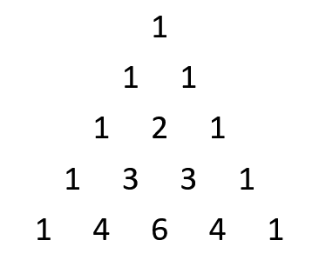
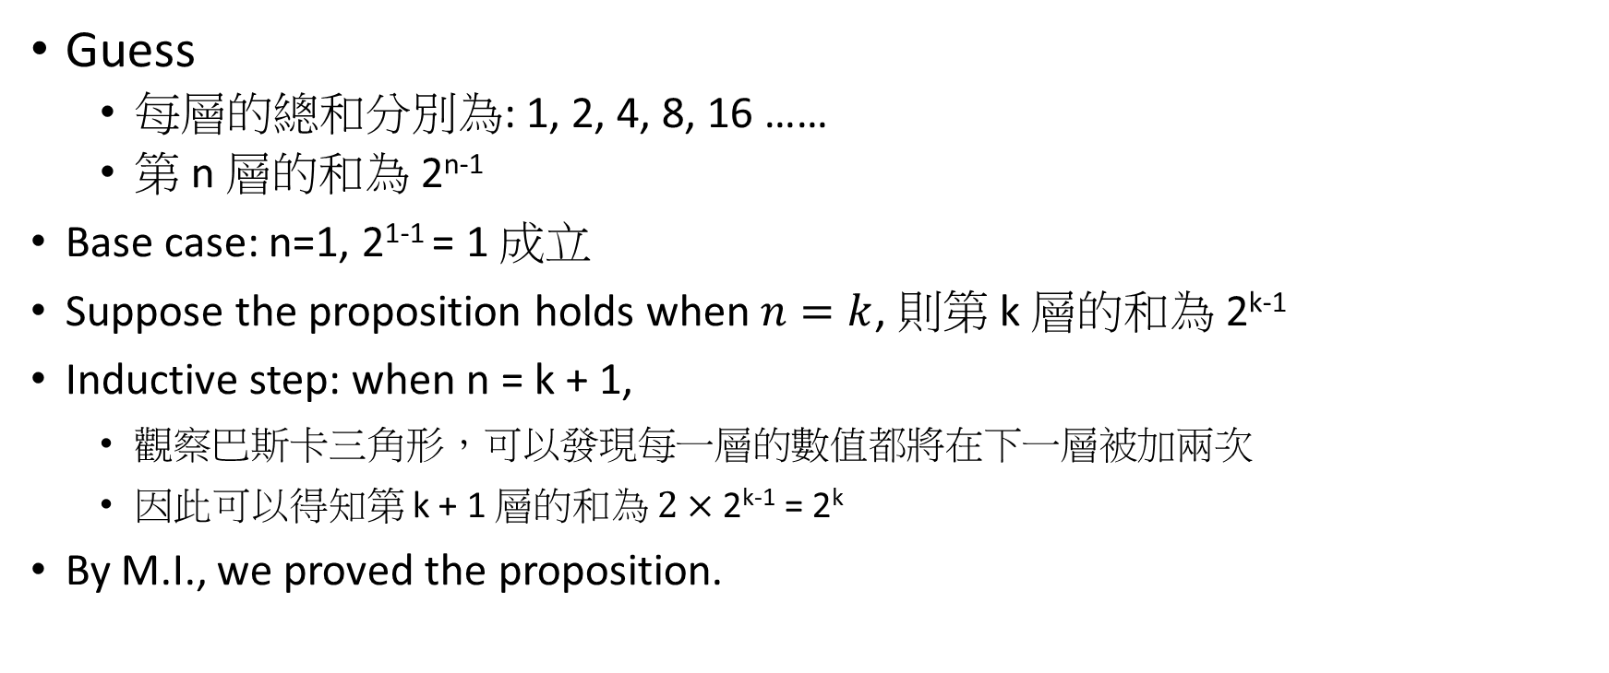
Q2.
Guess
  每層的總和分別為: 1, 2, 4, 8, 16 ……
  第 n 層的和為 2^{n-1}
  Base case: n=1, 2¹⁻¹ = 1 成立
  Suppose the proposition holds when $n=k$, 則第 k 層的和為 2^{k-1}
  Inductive step: when n = k + 1,
    觀察巴斯卡三角形，可以發現每一層的數值都將在下一層被加兩次
    因此可以得知第 k + 1 層的和為 $2×\text{2}\text{k}\text{−1}$ = 2^{k}
  By M.I., we proved the proposition.

Slide 9
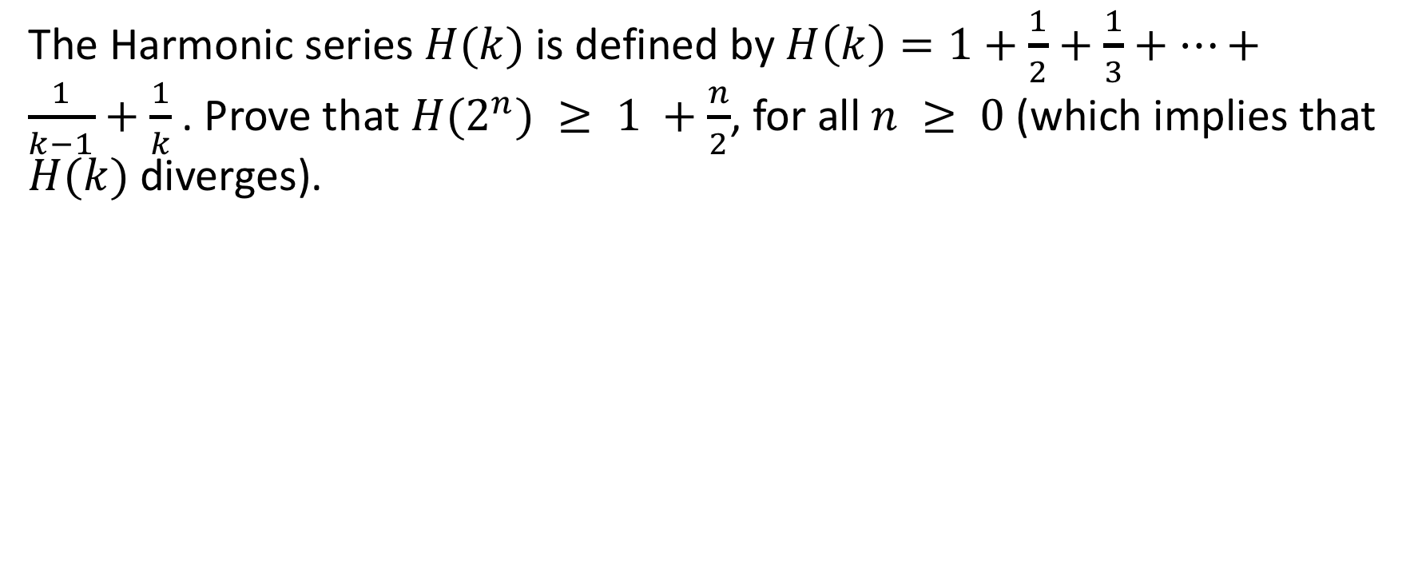
Q3.
The Harmonic series$H(k)$is defined by $H\left(k\right)=1+\frac{1}{2}+\frac{1}{3}+⋯+\frac{1}{k−1}+\frac{1}{k}$. Prove that $H(2^{n}) ≥ 1 +\frac{n}{2}$, for all $n ≥ 0$(which implies that $H(k)$diverges).

Slide 10
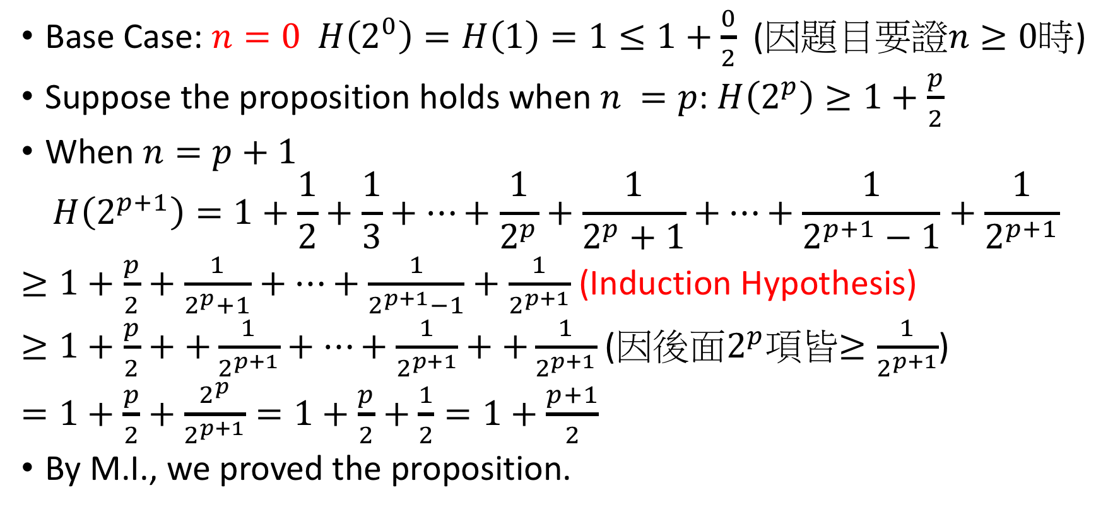
Q3.
Base Case: $n=0 H\left(2^{0}\right)=H\left(1\right)=1≤1+\frac{0}{2}$ (因題目要證$n≥0$時)
Suppose the proposition holds when $n =p$: $H\left(2^{p}\right)≥1+\frac{p}{2}$
When $n=p+1$
$$H\left(2^{p+1}\right)=1+\frac{1}{2}+\frac{1}{3}+⋯+\frac{1}{2^{p}}+\frac{1}{2^{p}+1}+⋯+\frac{1}{2^{p+1}−1}+\frac{1}{2^{p+1}}$$
$≥1+\frac{p}{2}+\frac{1}{2^{p}+1}+⋯+\frac{1}{2^{p+1}−1}+\frac{1}{2^{p+1}}$ (Induction Hypothesis)
$≥1+\frac{p}{2}++\frac{1}{2^{p+1}}+⋯+\frac{1}{2^{p+1}}++\frac{1}{2^{p+1}}$(因後面$2^{p}$項皆$≥\frac{1}{2^{p+1}}$)
$=1+\frac{p}{2}+\frac{2^{p}}{2^{p+1}}=1+\frac{p}{2}+\frac{1}{2}=1+\frac{p+1}{2}$
By M.I., we proved the proposition.

Slide 11
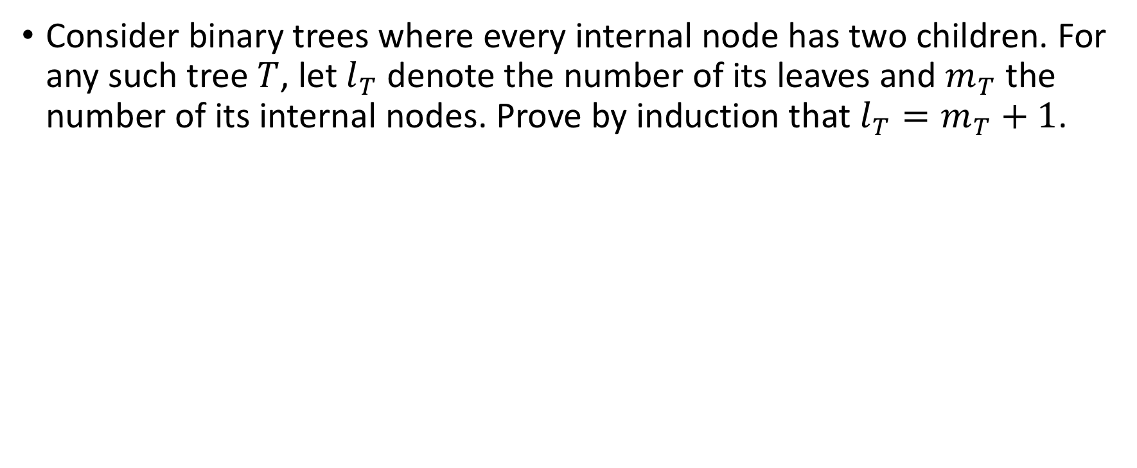
Q4.
Consider binary trees where every internal node has two children. For any such tree$T$, let $l_{T}$ denote the number of its leaves and $m_{T}$ the number of its internal nodes. Prove by induction that $l_{T}=m_{T}+1$.

Slide 12
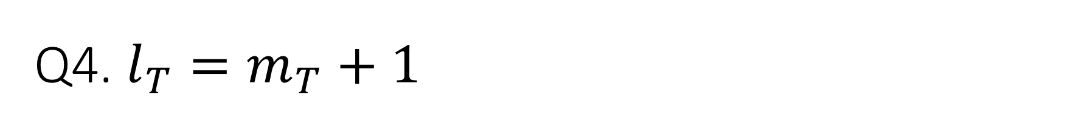
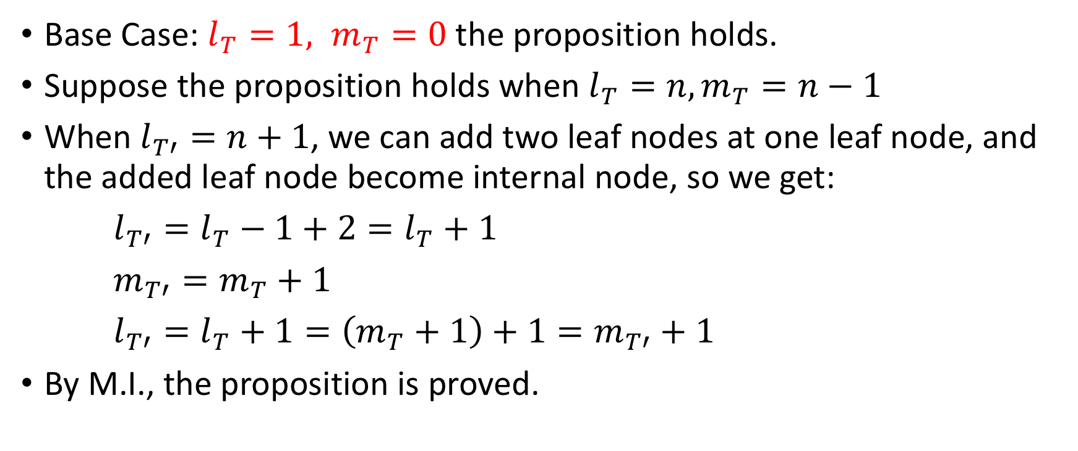
Q4. $l_{T}=m_{T}+1$
Base Case: $l_{T}=1, m_{T}=0$the proposition holds.
Suppose the proposition holds when $l_{T}=n, m_{T}=n−1$
When $l_{T′}=n+1$, we can add two leaf nodes at one leaf node, and the added leaf node become internal node, so we get:
$l_{T′}=l_{T}−1+2=l_{T}+1$
$m_{T′}=m_{T}+1$
$l_{T′}=l_{T}+1=\left(m_{T}+1\right)+1=m_{T′}+1$
By M.I., the proposition is proved.

Slide 13
Q4 Note.
Full Tree: Every internal node has two children

Slide 14
Q4 Note.
Perfect Tree: All internal nodes have two children and all leaves are at same level

Slide 15
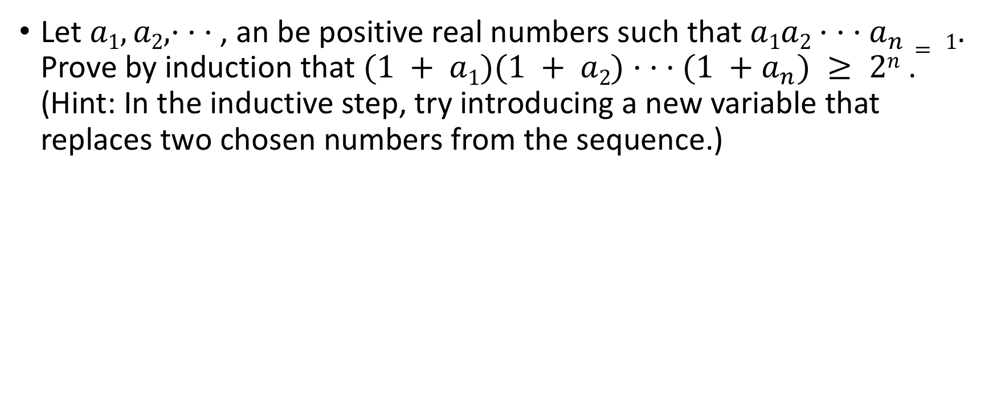
Q5.
Let $a1, a2, · · ·$, an be positive real numbers such that $a1a2· · ·a_{n}= 1$. Prove by induction that $(1 + a1)(1 + a2)· · ·(1 +a_{n}) ≥ 2n$. (Hint: In the inductive step, try introducing a new variable that replaces two chosen numbers from the sequence.)

Slide 16
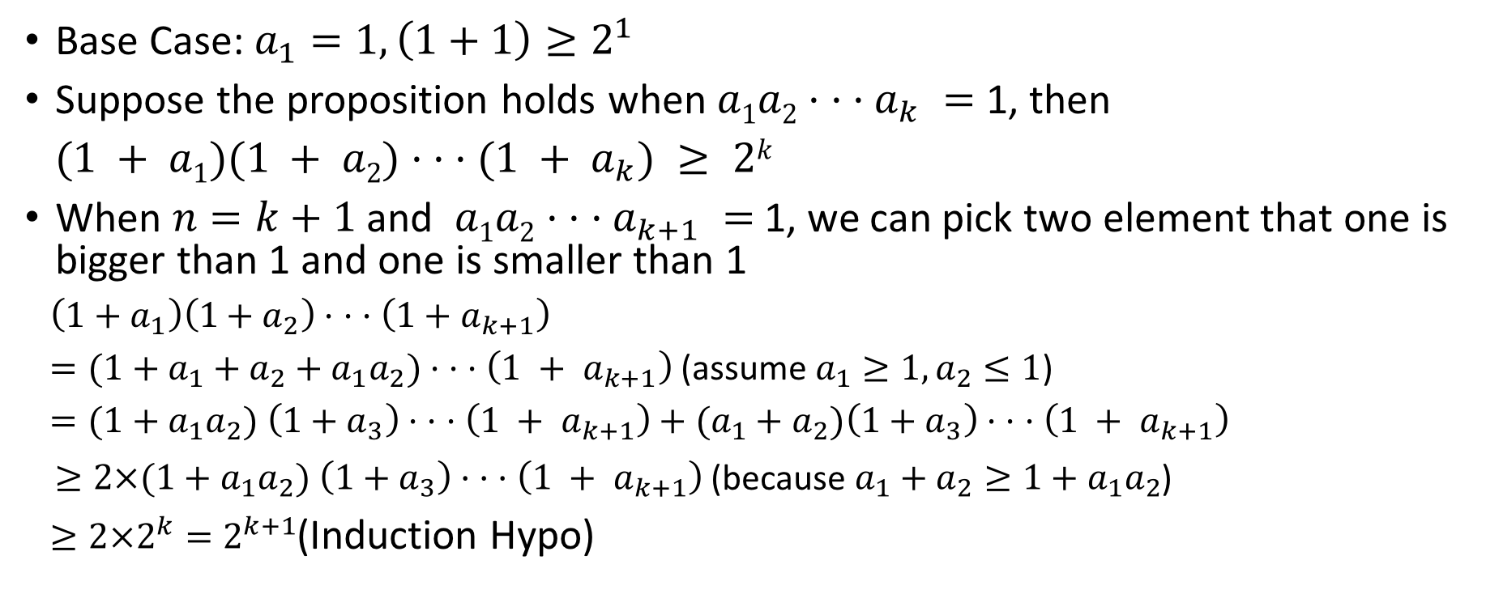
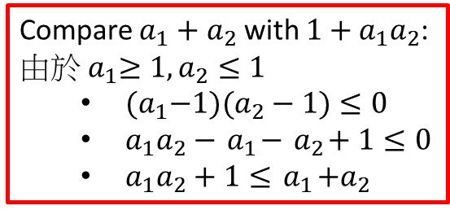
Q5.
Base Case: $a_{1}=1, \left(1+1\right)≥2^{1}$
Suppose the proposition holds when $a1a2· · ·a_{k} =$ 1, then
$(1 + a1)(1 + a2)· · ·(1 + a_{k}) ≥ 2k$
When $n=k+1$ and $a1a2· · ·a_{k+1} =$ 1, we can pick two element that one is bigger than 1 and one is smaller than 1
$\left(1+a_{1}\right)\left(1+a_{2}\right)· · ·\left(1+a_{k+1}\right)$
$=(1+a_{1}+a_{2}+{a_{1}a}_{2})$ $· · ·\left(1 + a_{k+1}\right)$ (assume $a_{1}≥1, a_{2}≤1$)
$=(1+{a_{1}a}_{2})$ $\left(1+a_{3}\right)· · ·\left(1 + a_{k+1}\right)+(a_{1}+a_{2})\left(1+a_{3}\right)· · ·\left(1 + a_{k+1}\right)$
$≥2×(1+{a_{1}a}_{2}) \left(1+a_{3}\right)· · ·\left(1 + a_{k+1}\right)$ (because $a_{1}+a_{2}≥1+a_{1}a_{2}$)
$≥2×2^{k}=2^{k+1}$(Induction Hypo)
Compare $a_{1}+a_{2}$ with $1+a_{1}a_{2}$:
由於${ a}_{1}≥1, a_{2}≤1$
  ${ (a}_{1}−1)(a_{2}−1)≤0$
  ${ a}_{1}a_{2}−{ a}_{1}−{ a}_{2}+1≤0$
  ${ a}_{1}a_{2}+1≤{ a}_{1}+a_{2}$

